Slide 1

Bird Feeder Digital Download
Brought to you by the Three Toed Bear

Slide 2
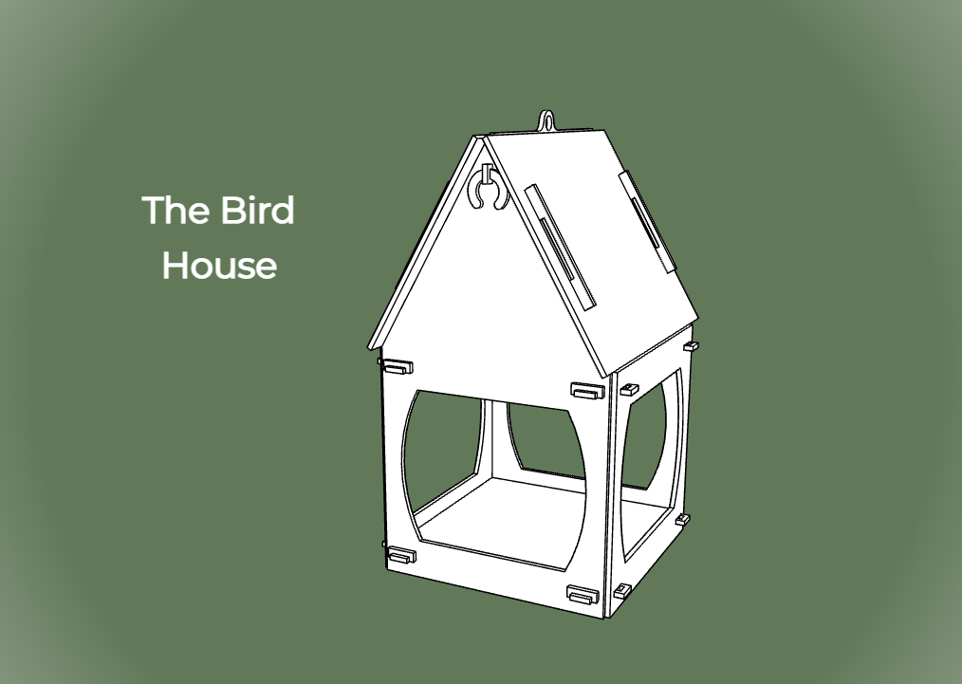

Slide 3

Thank you so much for your purchase and your interest in my designs. If you get the chance, pop on over to www.threetoedbear.com where there are lots of free downloads and some discount links for some others. Be sure to subscribe to the mailing list and be the first notified of new free designs, or when popular designs end up going online for free as a thank you to my customers!
You can also get notified of all the free files available on Facebook in the Glowforge Creators group at https://www.facebook.com/groups/303245694844372
And of course check me out on Instagram @threetoedbear https://www.instagram.com/threetoedbear/

Slide 4
Please test the notch and groove fits before cutting the entire assembly. Not all lasers or materials are created the same, so getting a kerf-fit that works for everyone is impossible. This will work the material I recommend on www.threetoedbear.com
If the fits don’t work for you, please feel free to shoot me an email at threetoedbear@gmail.com and we can work together to get you an assembly with the proper fits.

Slide 5
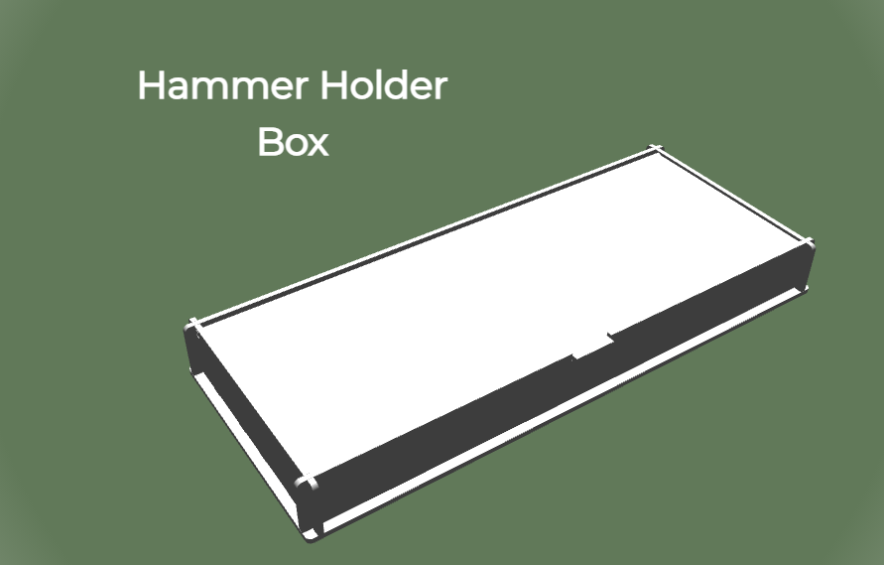

Slide 6
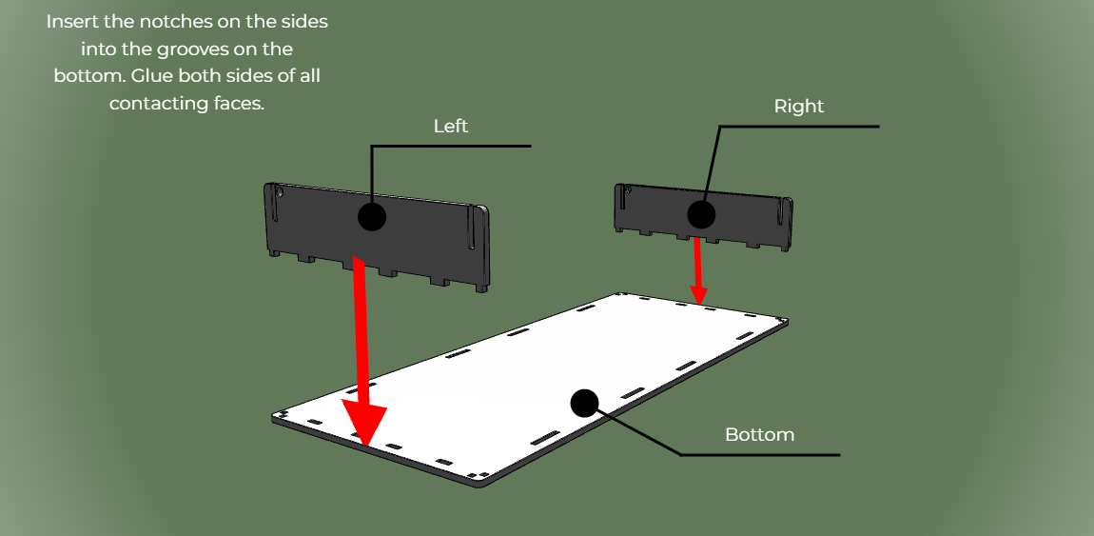

Slide 7
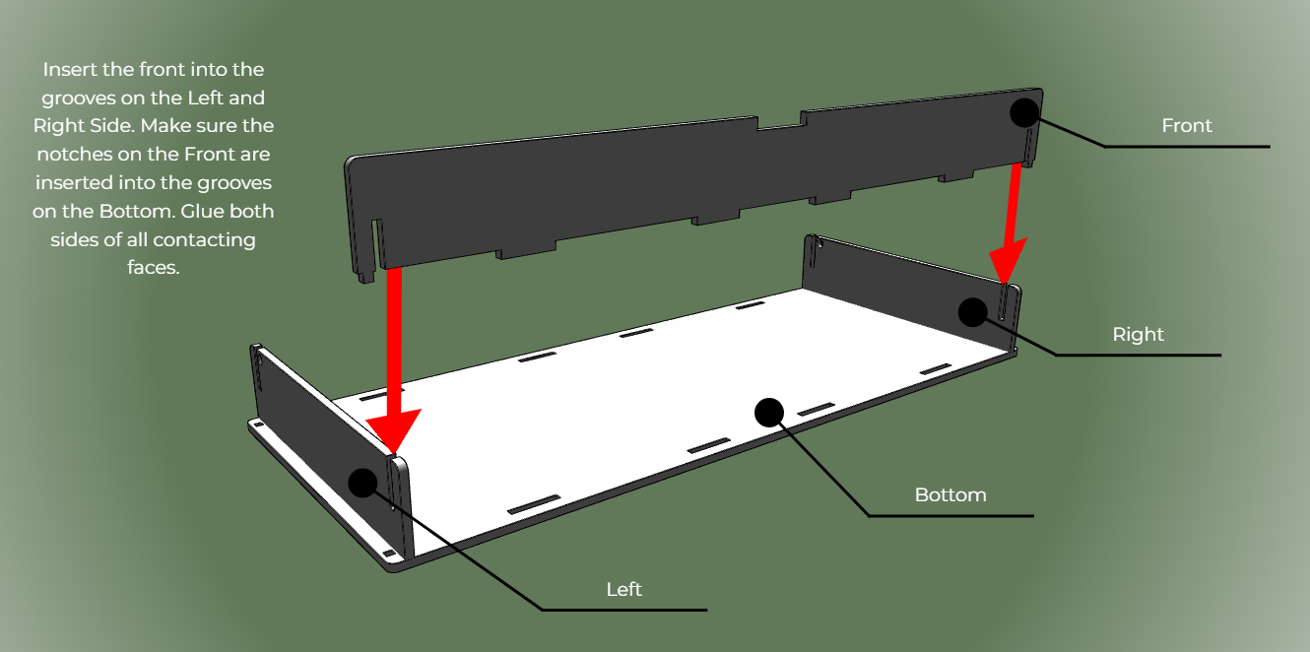

Slide 8
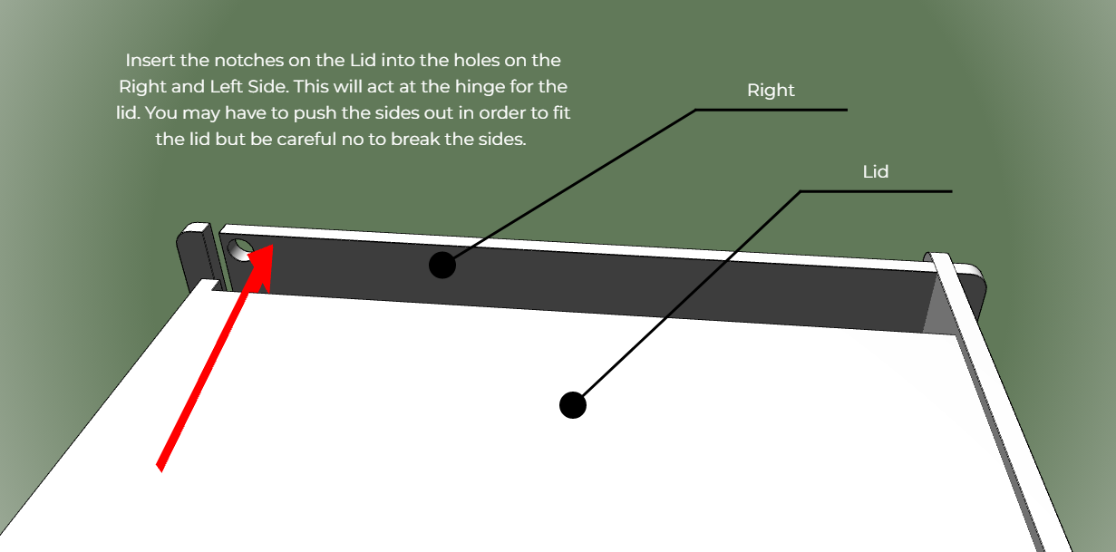

Slide 9
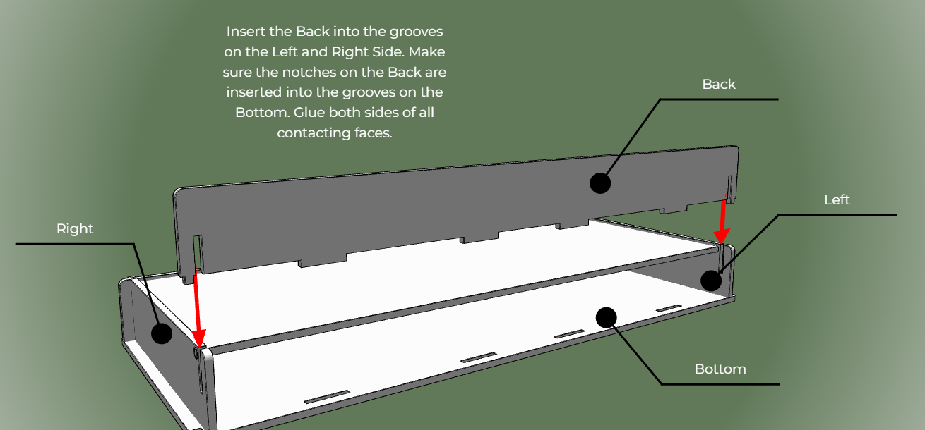

Slide 10
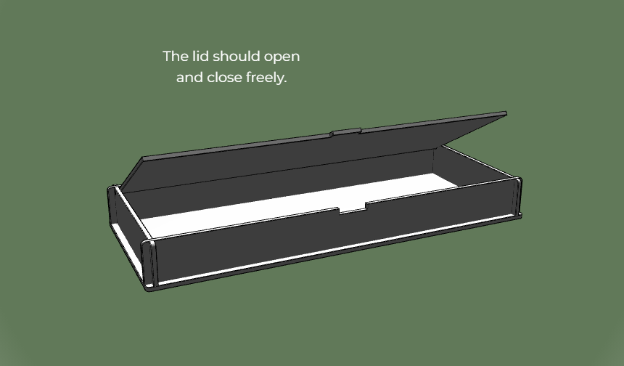

Slide 11
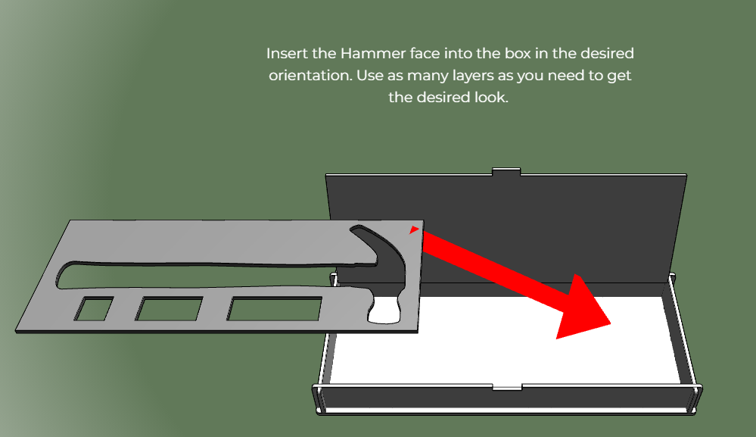

Slide 12
